Slide 1


Slide 2


Slide 3

2050
466 million people globally with hearing loss with over 900 million predicted by 2050.

Slide 4
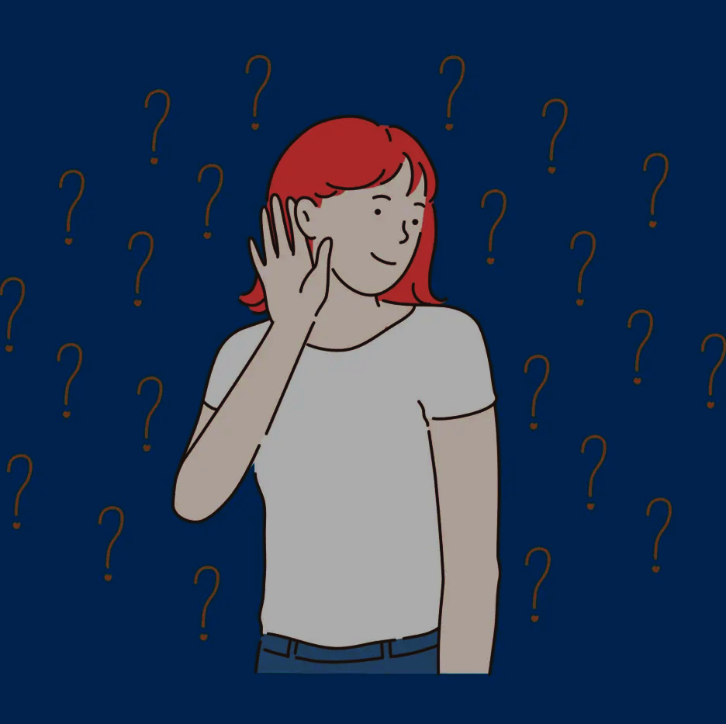
In Egypt
Over 3 million Egyptians impacted, with 22.4% of children under 4 years affected.

Slide 5
The Challenges We Face
Lack Of Accessibility
Communication

Slide 6

Introducing

Slide 7
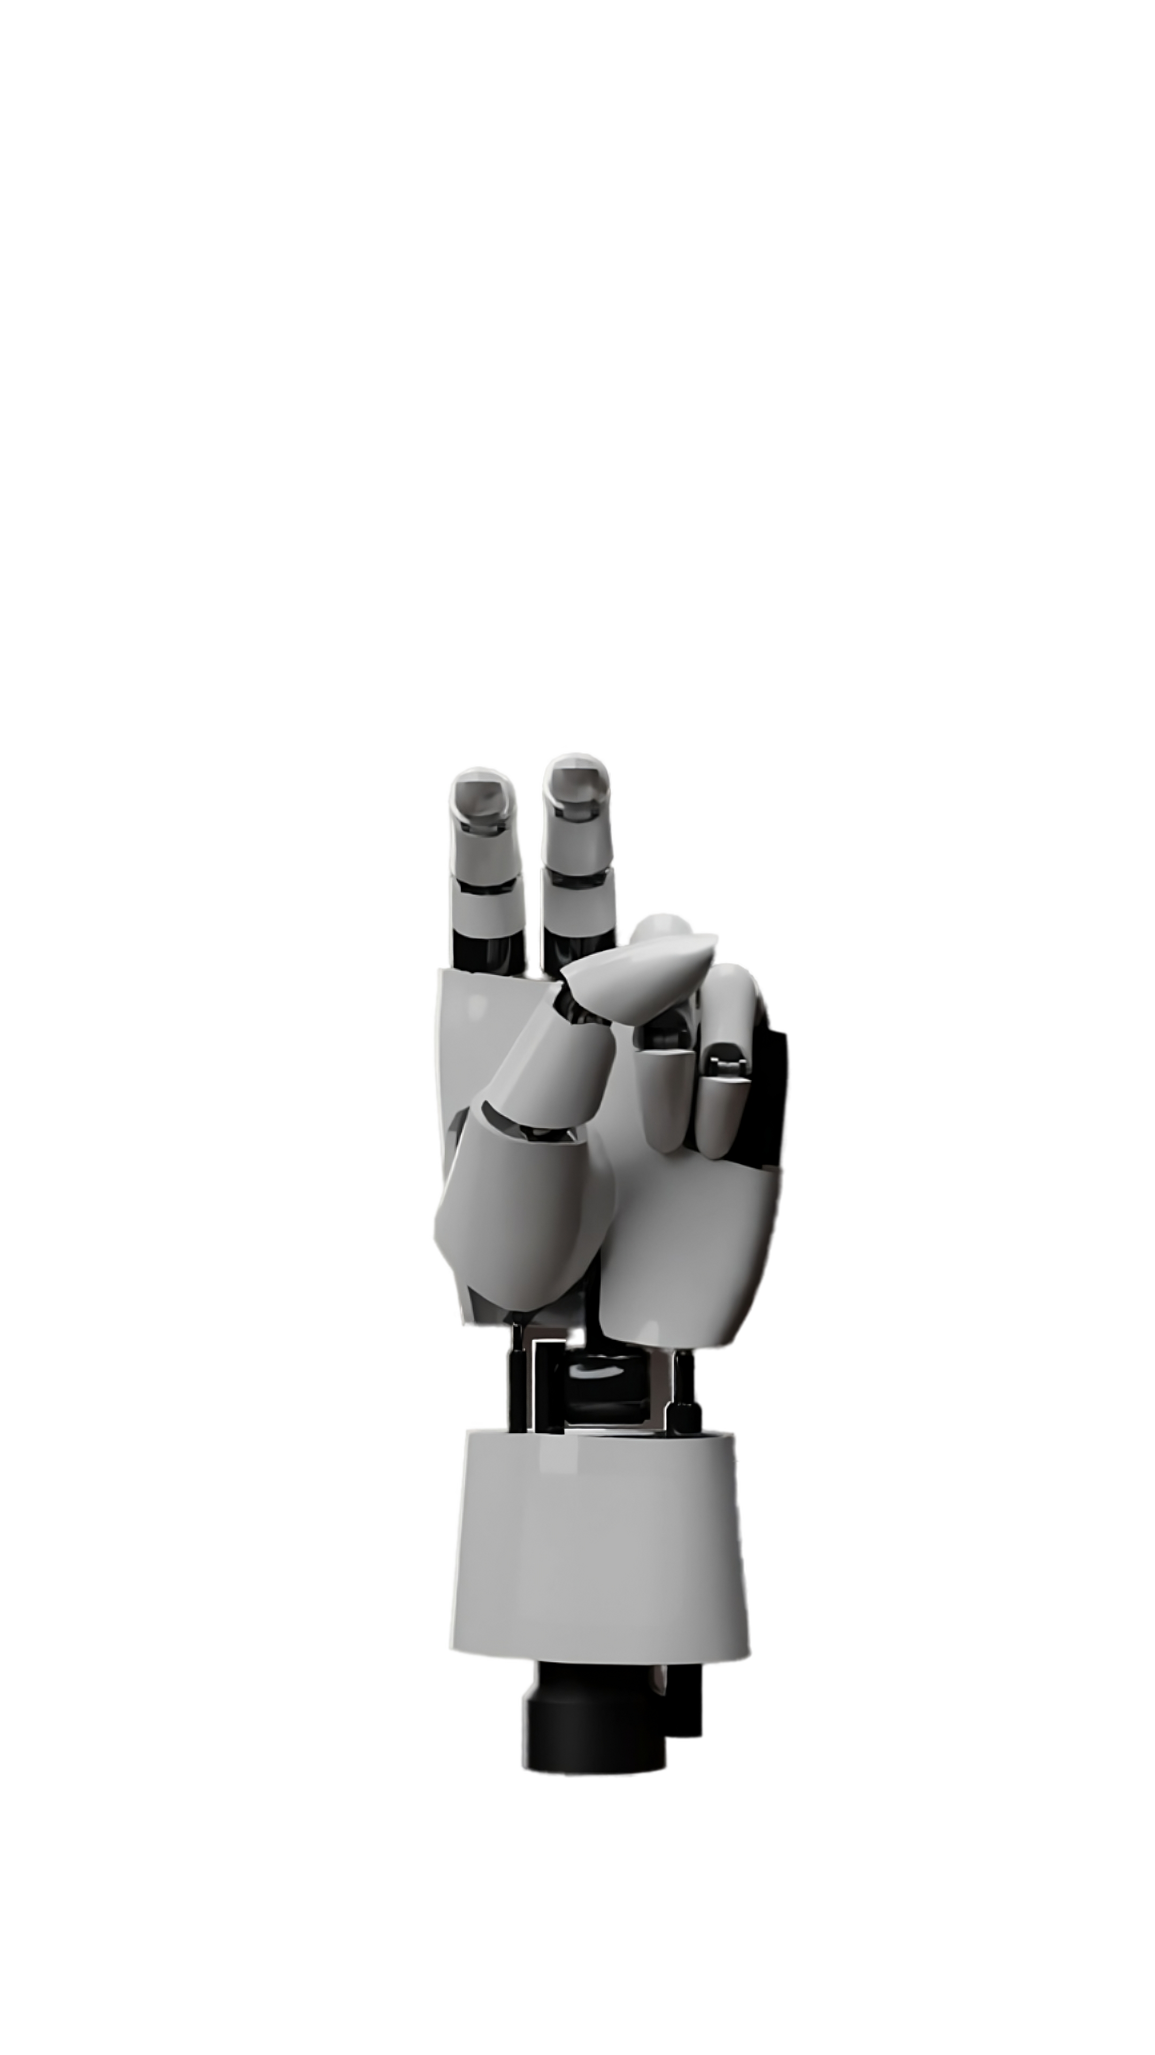
Voice of the Voiceless

Slide 8
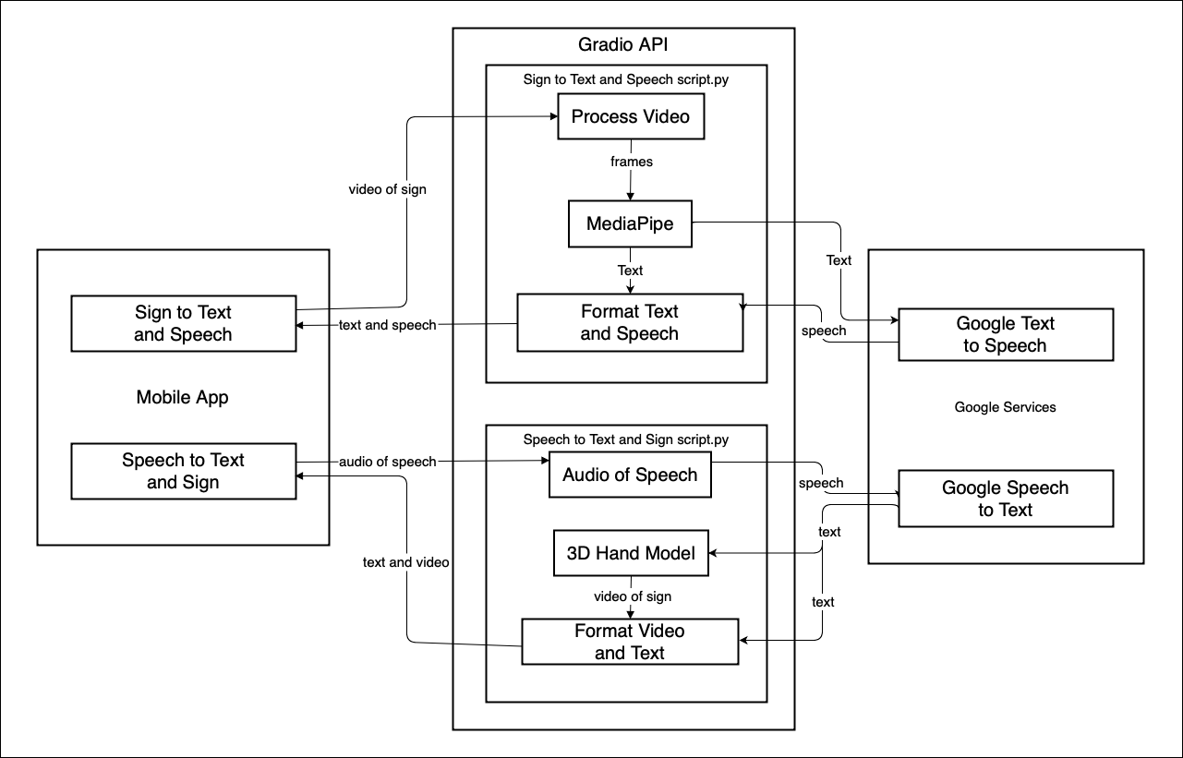
System Architecture

Slide 9
App Demo

Slide 10
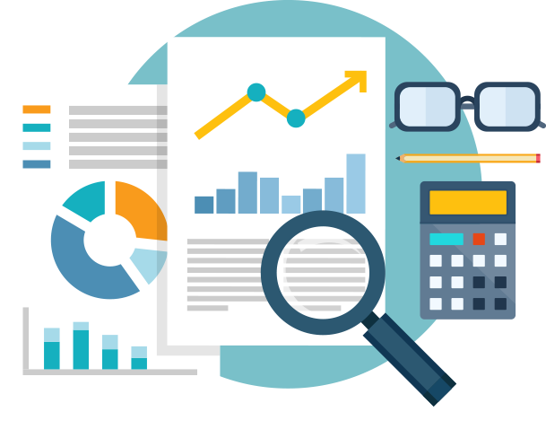
Data is the backbone for Our model

Slide 11
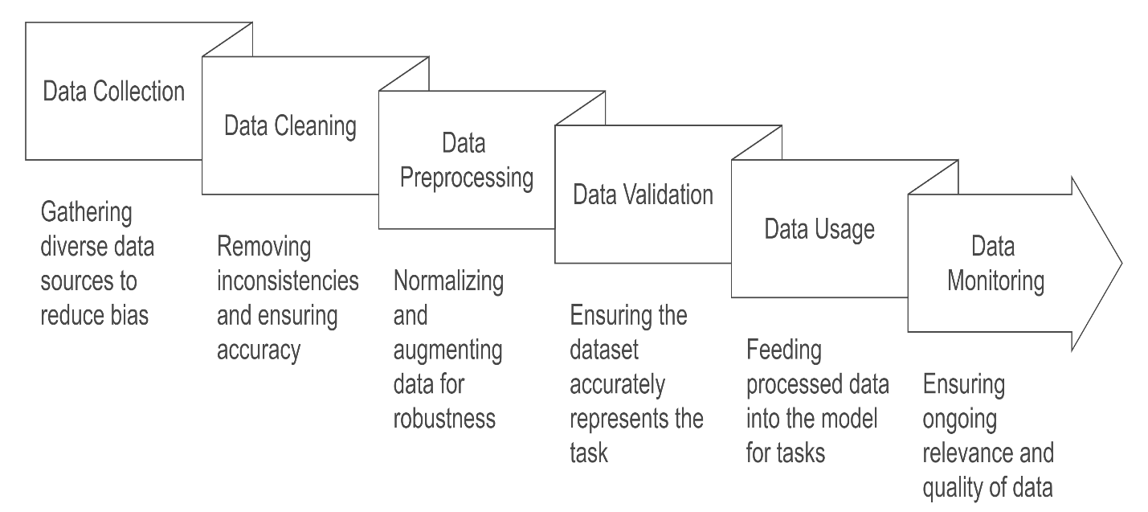
Our Dataset’s Life Cycle

Slide 12
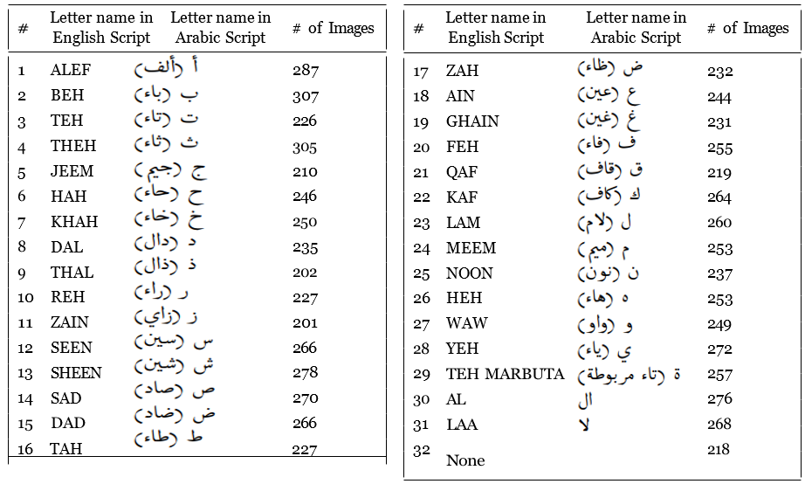
ArSL Dataset Overview
"Our dataset, sourced from Kaggle, is the RGB Arabic Alphabet Sign Language (AASL) dataset."
Key stats (mention briefly):
7,857 labeled images | 31 Arabic letters + "None" class | Contributions from 200+ participants.

Slide 14
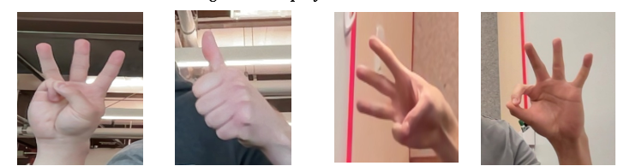
The "None" Folder
Reducing False Positives & Preparing for MediaPipe Integration

Slide 15
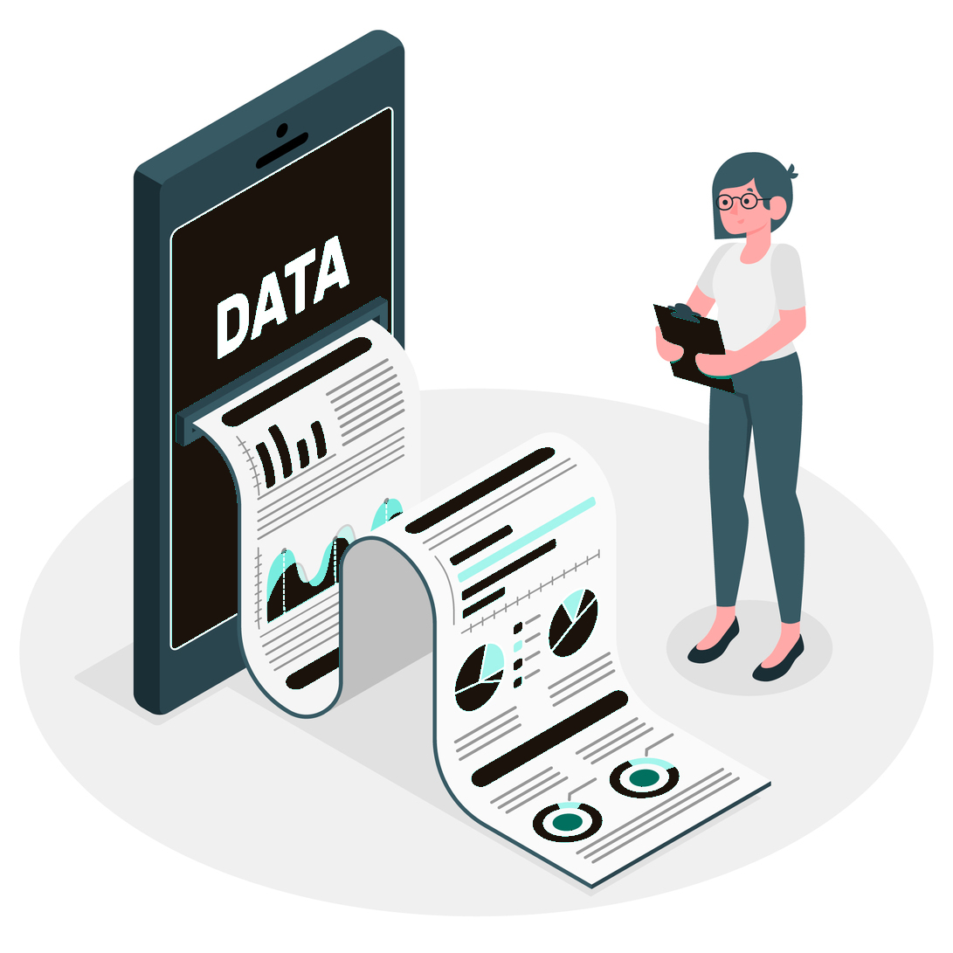
Dataset
Enhancement
"We enhanced robustness through data augmentation (flipping, rotation, scaling, lighting adjustments) and synthetic data generation."

Slide 16
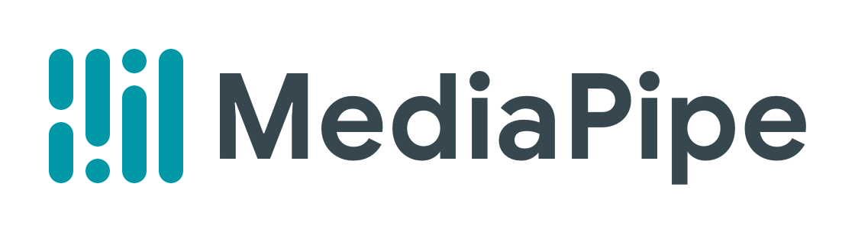
Gesture Recognition using:

Slide 17
What is ?
open-source framework developed by Google
cross-platform tools for building machine learning pipelines
pre-trained models for
face detection
hand tracking
gesture recognition
pose estimation
object detection.

Slide 18
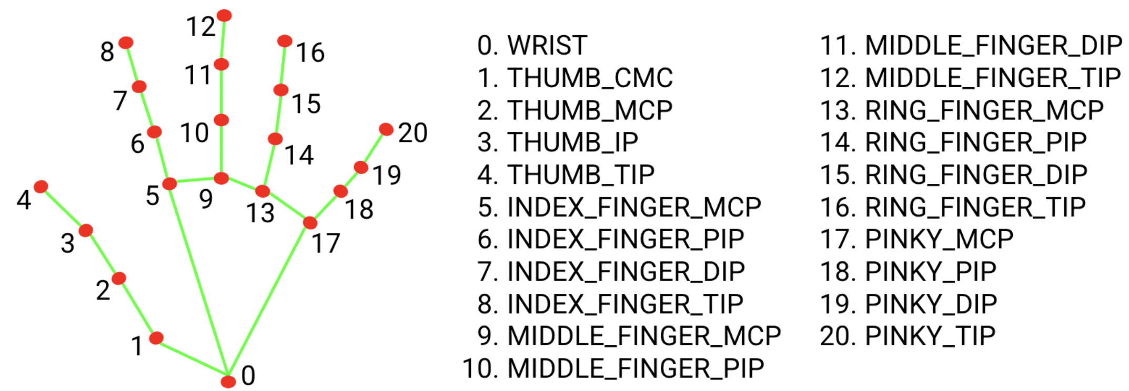
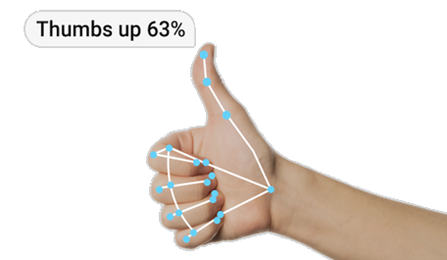
Gesture Recognition
hand landmark model
gesture classification model

Slide 19
Hand Landmark Model
- Detects 21 hand-knuckle coordinates.
- Trained on 30K real-world images

Slide 20
Gesture Classification Model
- Classifies gestures based on 21 hand-knuckle coordinates.

Slide 21
Customize Gesture Recognition: Model Maker
existing ML model
classification layers
rebuilt layers
input data
cat
dog
parrot

Slide 22
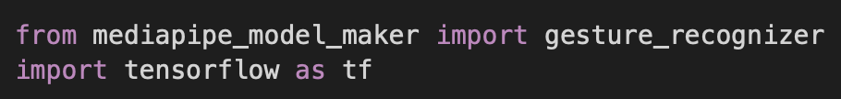
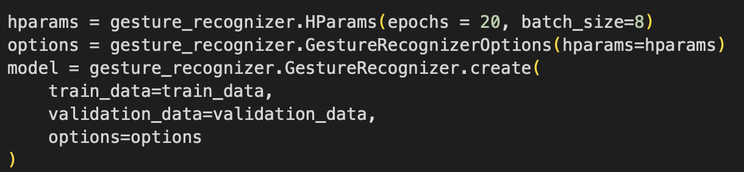
Customize Gesture Recognition: Google Colab
1- Importing Packages:
2-Setting training hyperparameters and starting training:

Slide 23
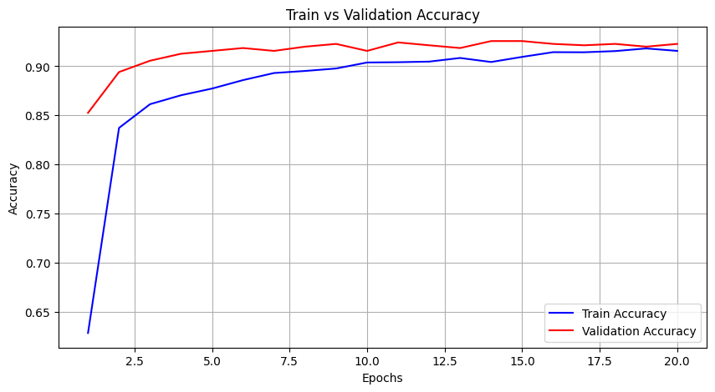
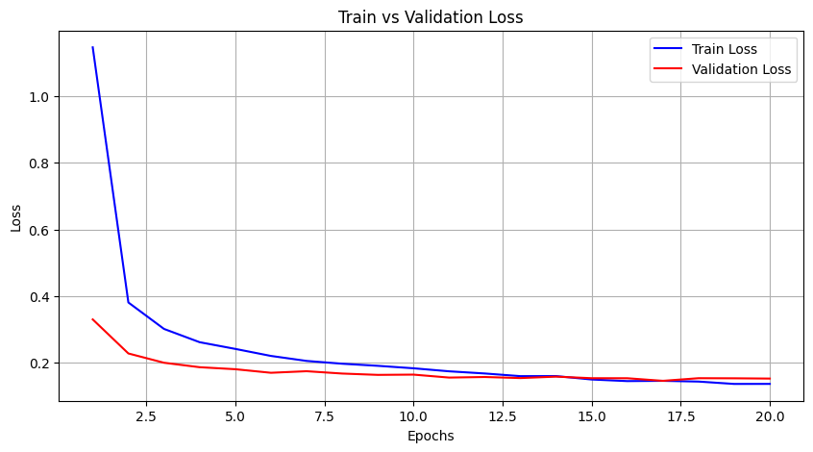
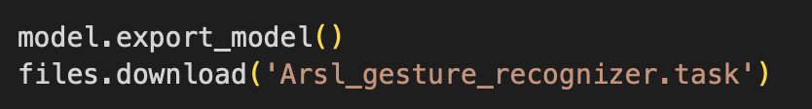
Customize Gesture Recognition: Google Colab
3- Accuracy and Loss:
- Train accuracy: 91.32%
- Validation accuracy: 92.13%
- Train accuracy: 13.6%
- Validation accuracy: 20.8%
4- Saving the model:

Slide 24
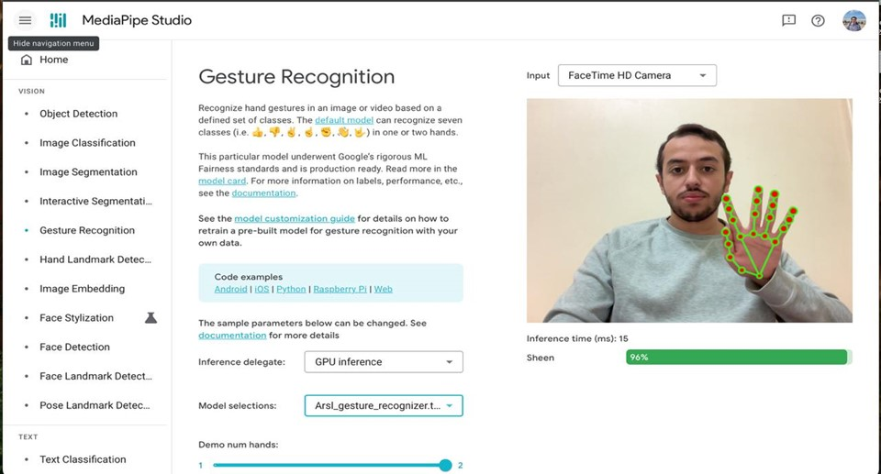
Testing Custom Gesture Recognition Model: MediaPipe Studio

Slide 25
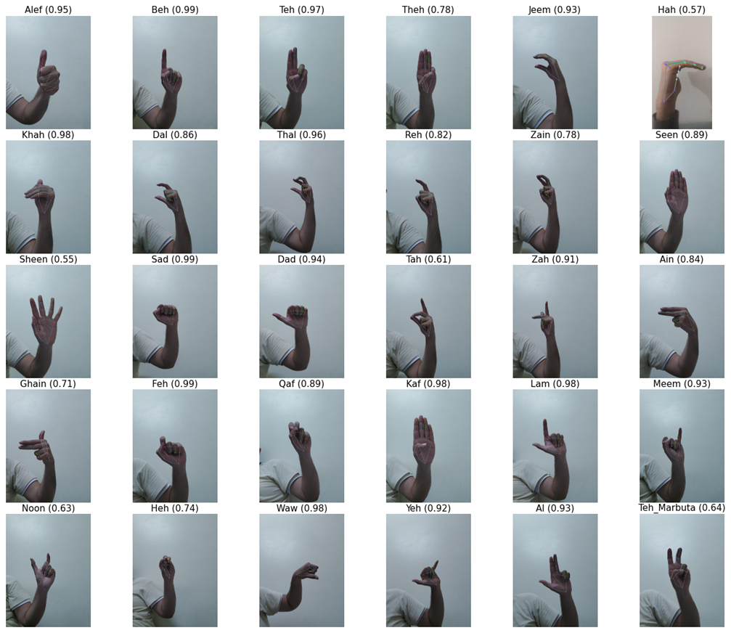
Testing Custom Gesture Recognition Model: Google Colab

Slide 26
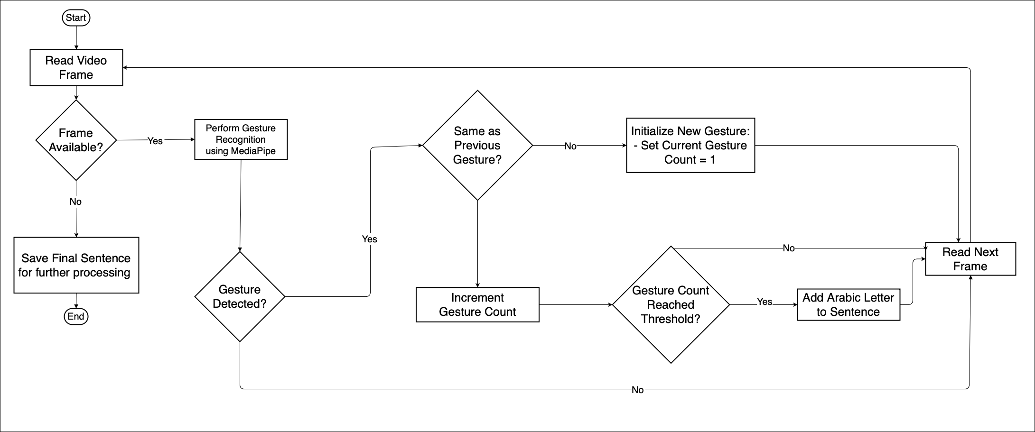
Integration between MediaPipe and SAHLA

Slide 27

Google Cloud Speech APIs
WHY?
Scalability
Accuracy
High-Quality Speech Recognition
Customizability
personalized interaction
Ease of Integration
Language Support

Slide 28



Building complex infrastructure and machine learning models
Google Cloud’s powerful APIs
Handling the heavy lifting
Scalability and reliability to grow with the demands of the users
Maintaining performance and availability at all times.

Slide 29



Text-to-Speech API features
Voice Customization
Audio Configuration
WaveNet Voices

Slide 30
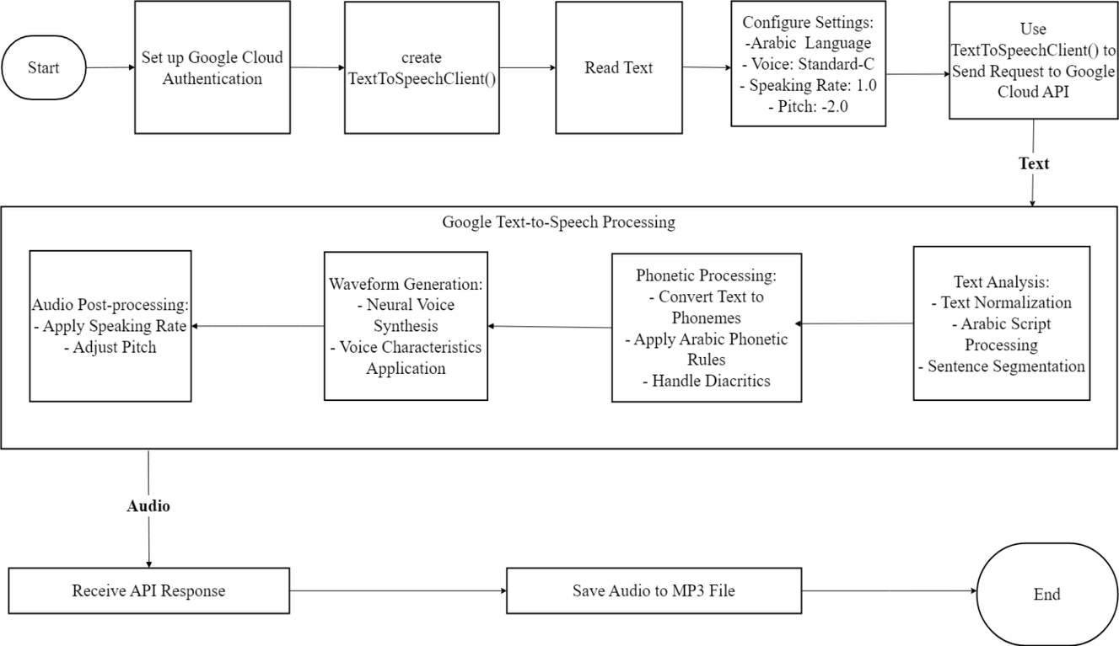
The integration of Google Cloud’s Text-to-Speech API into SAHLA

Slide 31

T-T-S Settings
Language: Arabic is selected for the output speech.
Voice Model: The "Standard-C" voice is chosen for this use case.
Speaking Rate: Set to 1.0 for a natural pace.
Pitch: Adjusted to -2.0 for a slightly deeper tone.

Slide 32
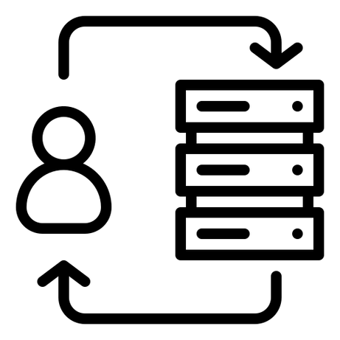
The API processes the request through several stages:
Text Analysis:
The text is normalized and segmented into appropriate sentences.
Arabic script is handled with rules specific to the language.
Phonetic Processing:
The text is converted into phonemes applying Arabic-specific phonetic rules.
Waveform Generation:
Neural voice synthesis creates a high-quality audio waveform.

Slide 33

Challenges & Considerations
Voice Selection
Audio File Size and Playback
Real-Time Performance

Slide 34





Slide 35
Speech-to-Text API features
Real-Time Transcription
Speaker Diarization
Punctuation and Formatting

Slide 36
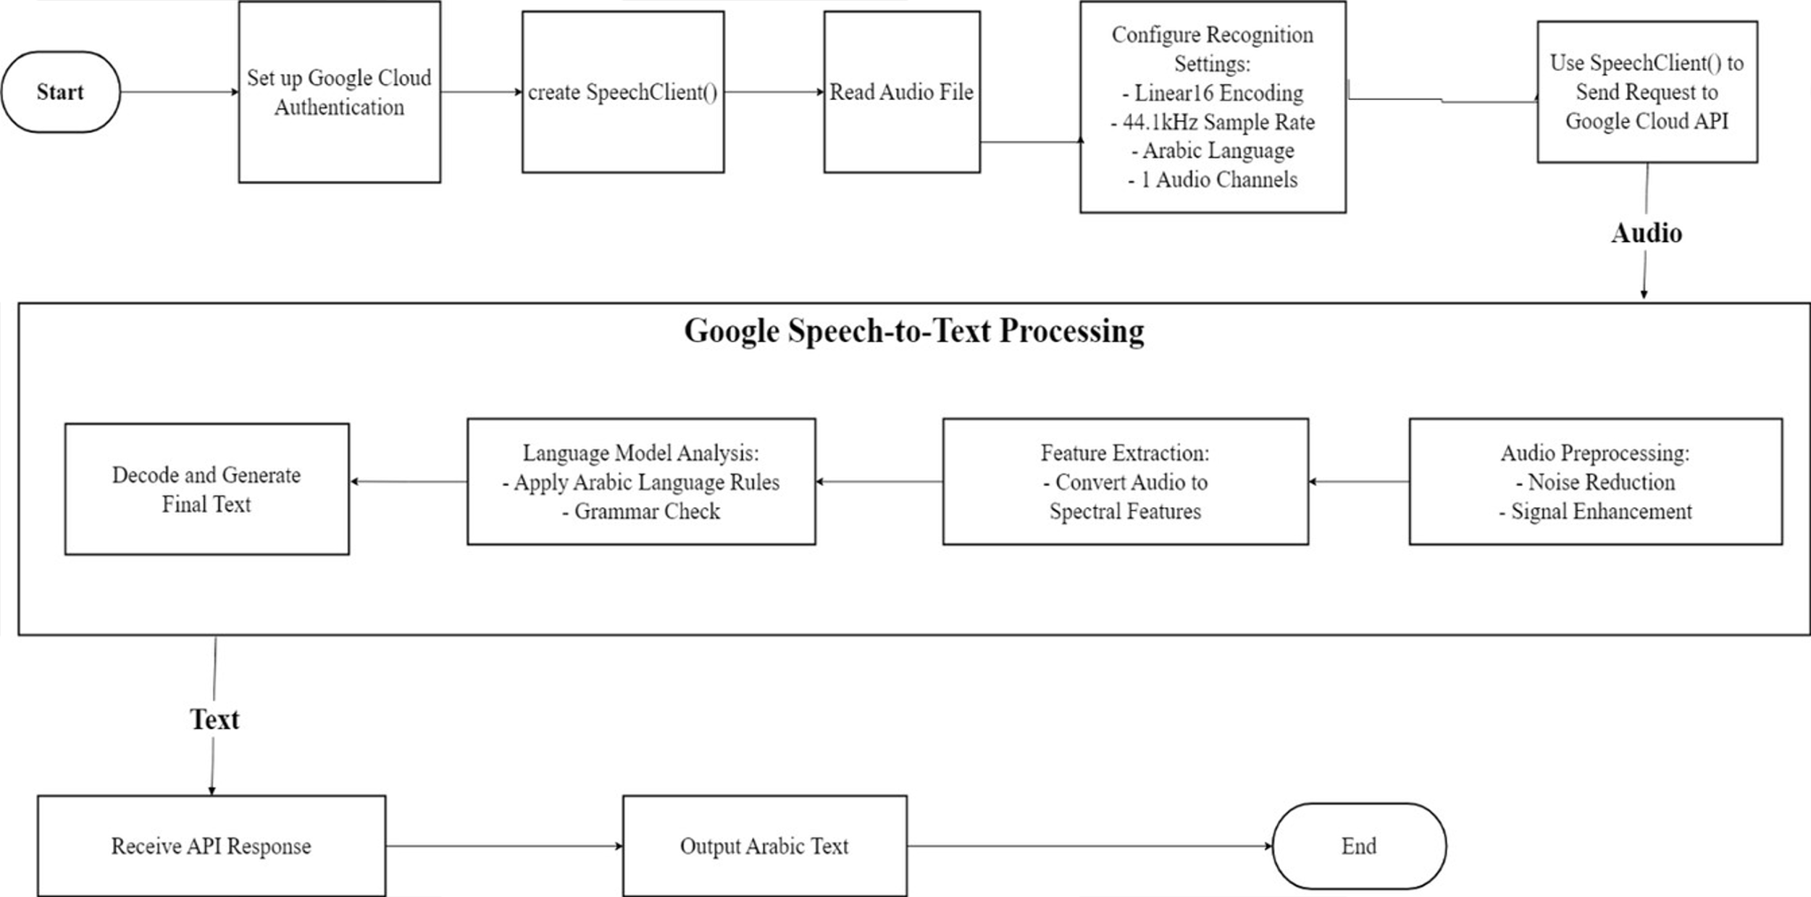
The integration of Google Cloud’s Speech-To-Text API into SAHLA:

Slide 37
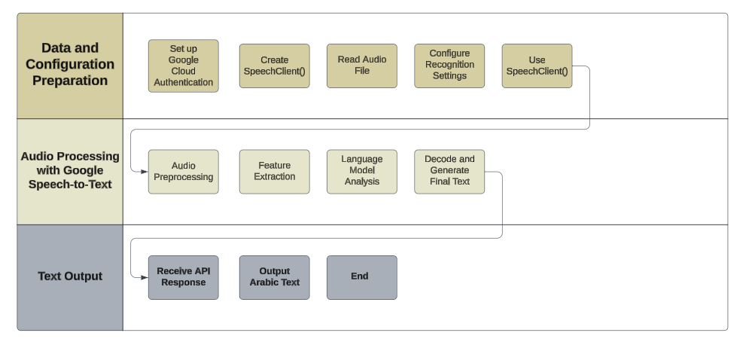
Google Speech-to-Text API Processing Workflow

Slide 38

The API processes the request through several stages:
Set up Google Cloud Authentication
Create SpeechClient()
Read Audio File
Configure Recognition Settings Set parameters for the audio input:
Encoding: Linear16
Sample Rate: 44.1 kHz
Language: Arabic
Audio Channels: 1
Use SpeechClient() to Send Request to Google Cloud API

Slide 39

Audio Processing with Google Speech-to-Text
Audio Preprocessing:
Noise reduction
Signal enhancement
Feature Extraction:
The audio is analyzed and converted into spectral features.
Language Model Analysis:
Arabic language rules and grammar checks are applied.
Decode and Generate Final Text Translate the processed data into meaningful, readable text.

Slide 40

Text Output
1- Receive API Response Retrieve the processed text output from the API.
2- Output Arabic Text Display or store the generated Arabic text
3- End

Slide 41
Challenges & Considerations
Accuracy of Transcription
Handling Different Accents and Dialects
Latency in Real-Time Transcription
Managing Multiple Audio Formats

Slide 42

3D Modeling Using:
WHY?
Blender is the free and open-source 3D creation suite

Slide 43
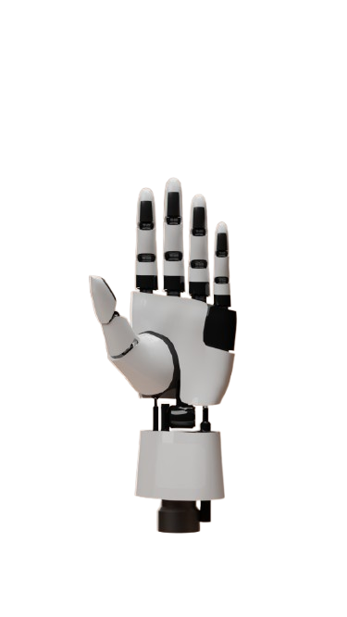
How Did We
Use Blender?
3D hand model that performs Arabic sign language gestures.

Slide 44
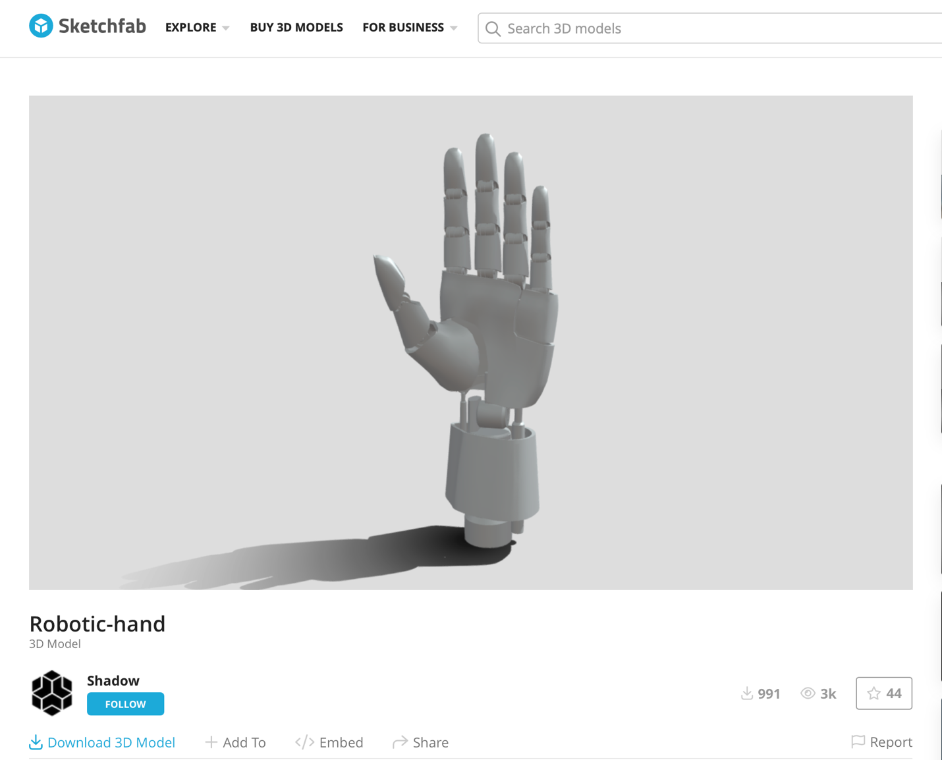

Hand Model Selection

Slide 45
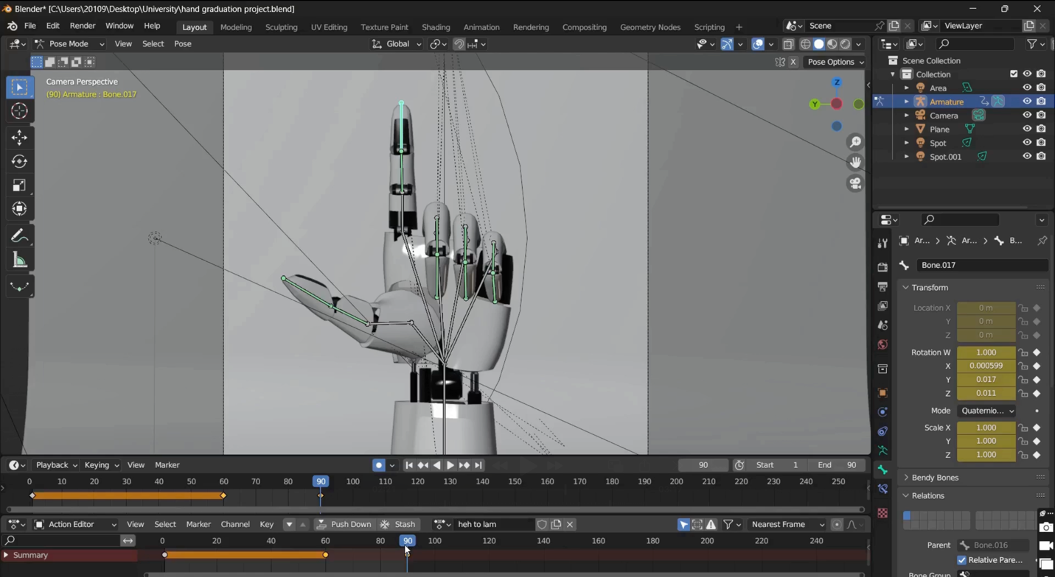
What is Rigging?
process of creating a skeleton for a 3D model to control its movement.

Slide 46
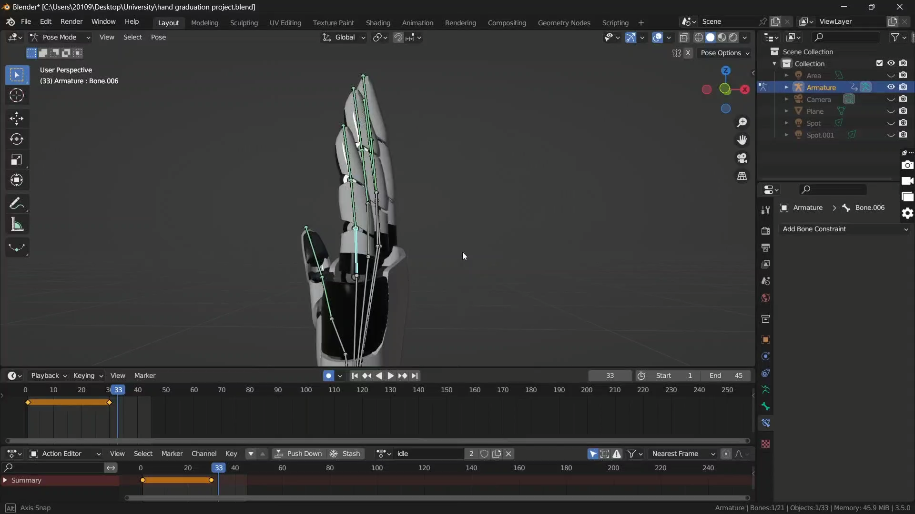
Inverse Kinematics “IK”
position the last bone and the other bones are positioned automatically.

Slide 47
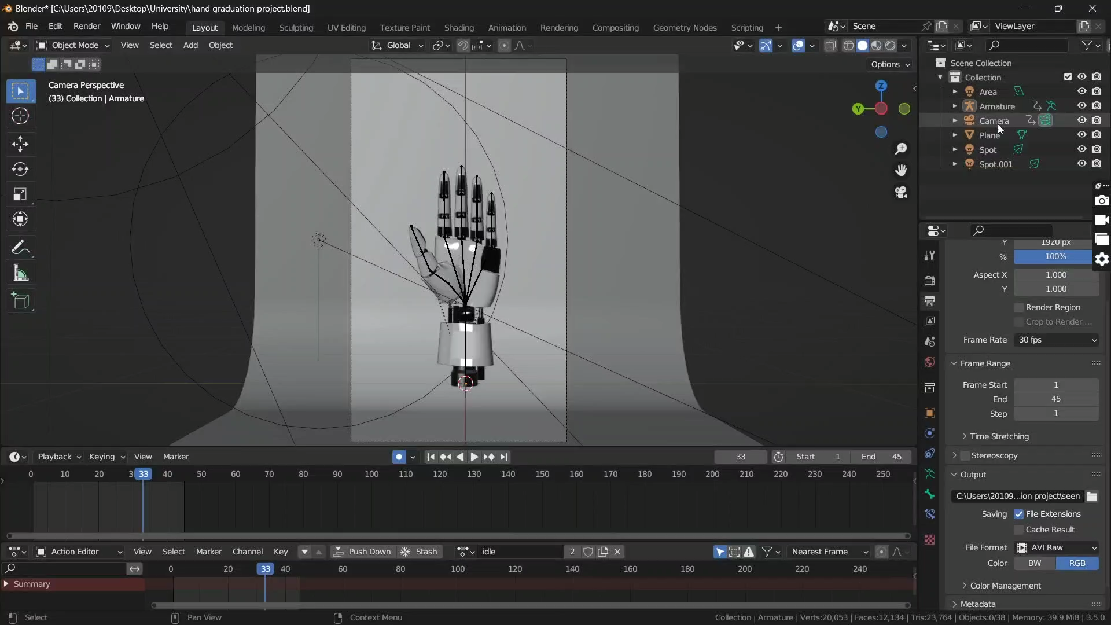
Scene Preparation
align with our visual identity,

Slide 48
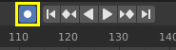
Animating
& Rendering
Each animation has 45 frames:
Frames 1-15: first letter gesture
Frames 16-30: Transition from first letter to the second letter gestures.
Frames 31-45: Hold second the letter gesture.
Auto keyframing was used to ensure smooth transitions.
Rendering Settings:
Resolution: 1920x1080 in portrait mode .
Format: AVI Raw, converted to MP4.

Slide 49
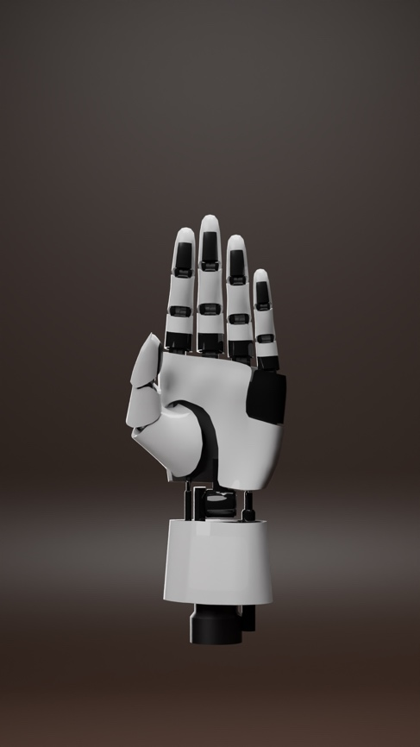
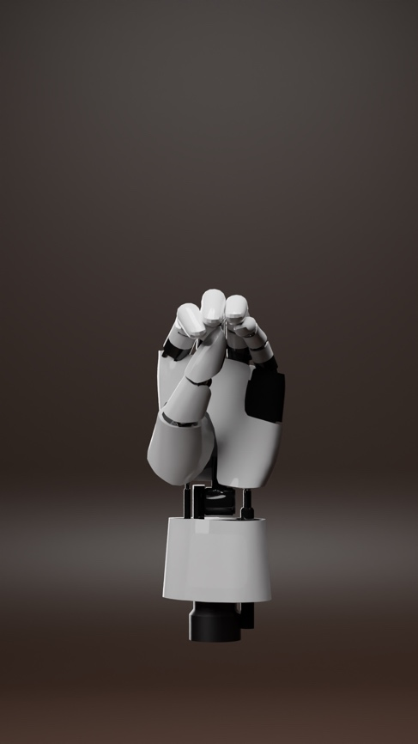
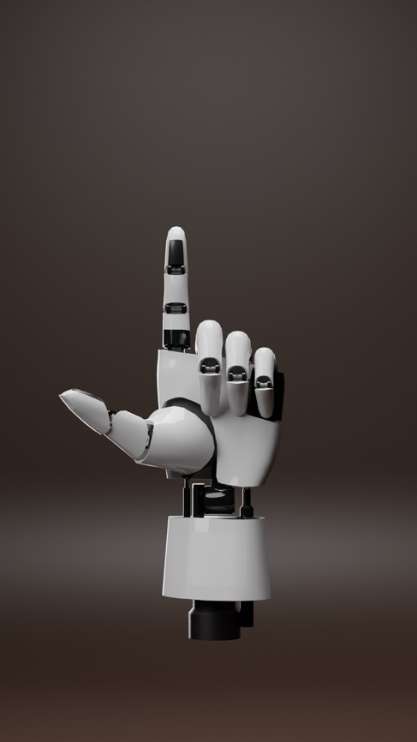
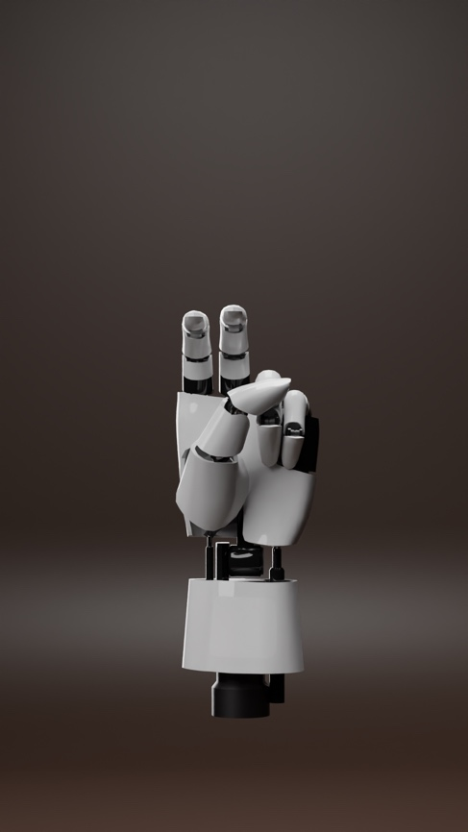
Final Result Sample Letters
Seen(س)
Heh (ه)
Lam(ل)
Teh-marbota(ة)

Slide 50
Integrating With SAHLA

Slide 51
Word
سهلة
Separate word to letters
ة
ل
ه
س
Use moving window to create letter combinations
ل ة
ه ل
س ه
Map letter combinations to sign videos
+
+
Lam_teh.mp4
Heh_lam.mp4
Seen_heh.mp4
Concatenate sign videos
Output.mp4

Slide 52
What Is
UI / UX ?

Slide 53
UI Core Principles
Simplicity
Accessibility
Consistency

Slide 54
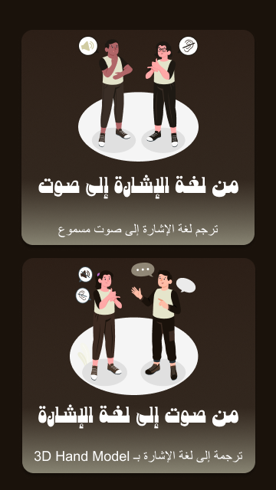
Simplicity

Slide 55
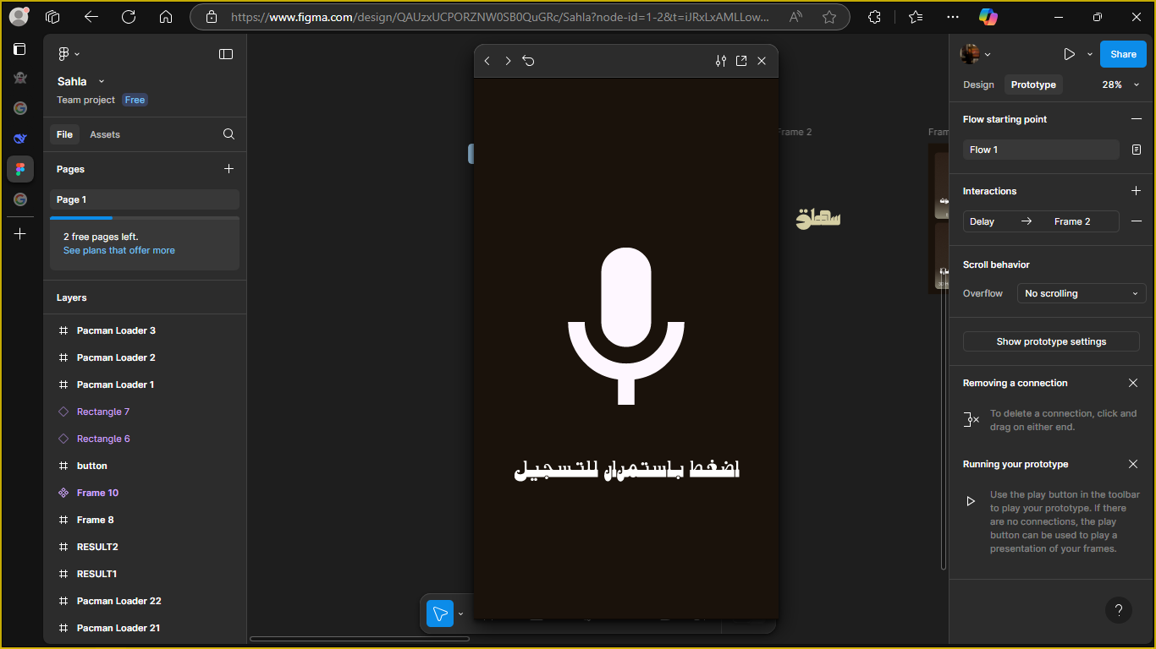
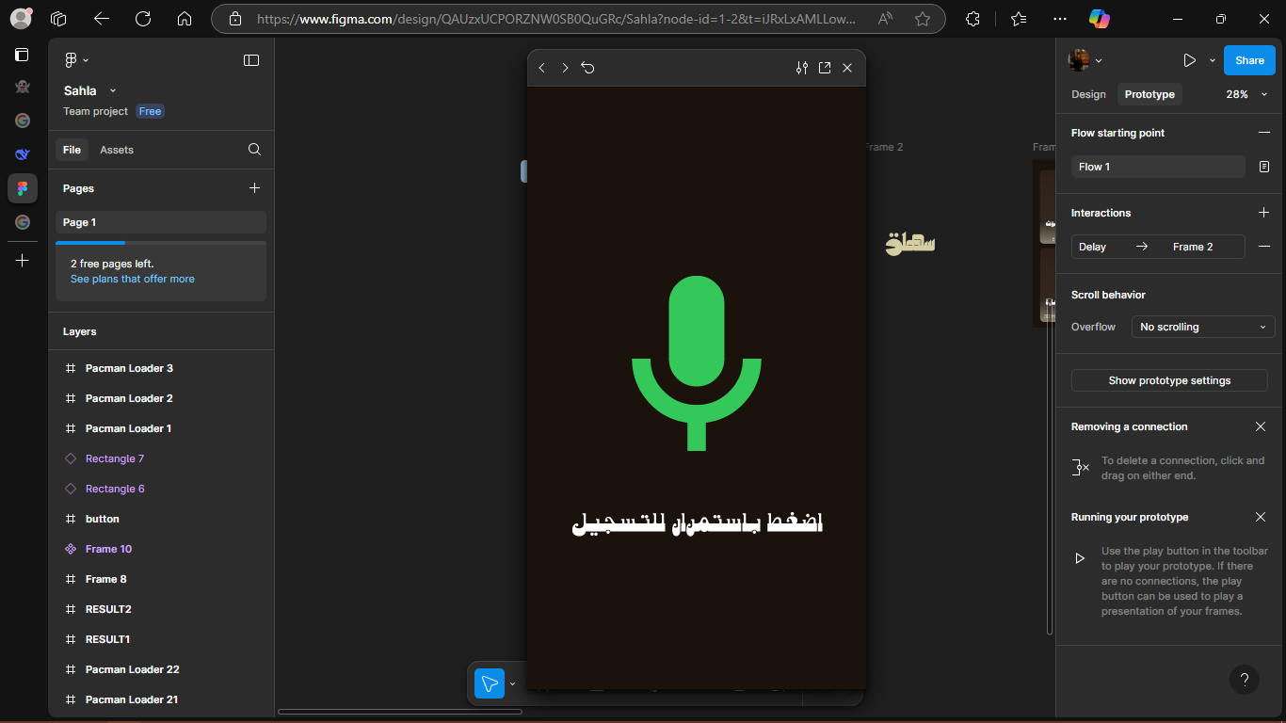
Accessibility

Slide 56

Consistency

Slide 57
SAHLA Visual Identity
1. LOGO

Slide 58

SAHLA Visual Identity
2. Mascot

Slide 59

SAHLA Visual Identity
3. Color Palette

Slide 60



SAHLA Visual Identity
4. Loading Screens

Slide 61
Tools Used For UI
Figma
Adobe Photoshop
Adobe illustrator

Slide 62

Mobile App Development Using:

Slide 63
React Native Features
Cross Platform
Community Support
Code Reuse
Open Source

Slide 64
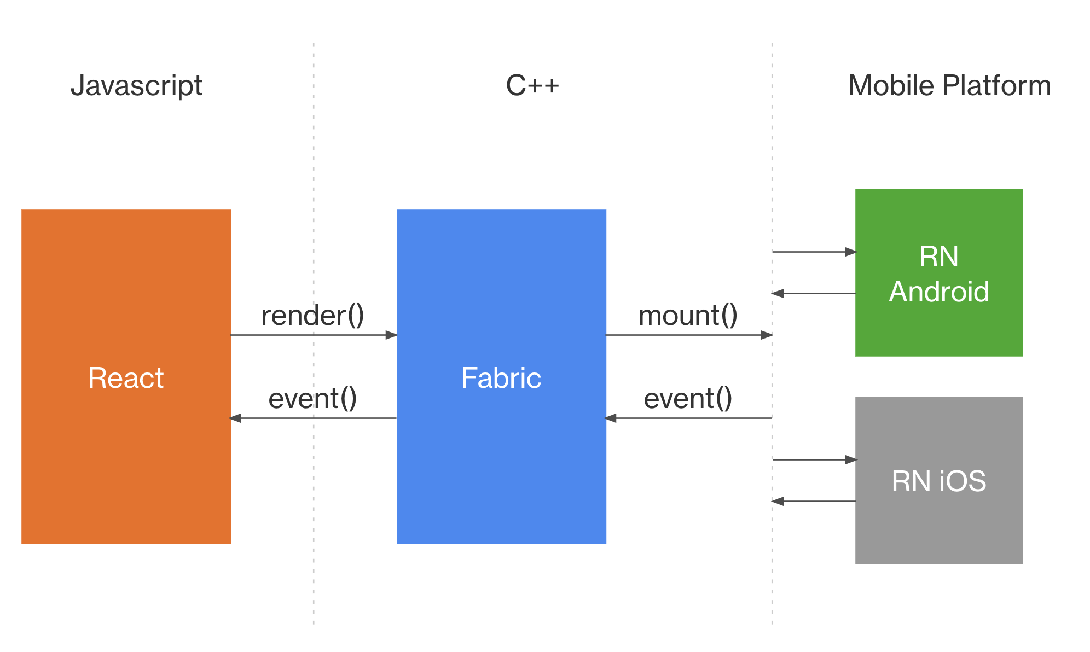
React Native Architecture
React Shadow Tree
platform-specific Host View Trees
React Element Tree

Slide 65



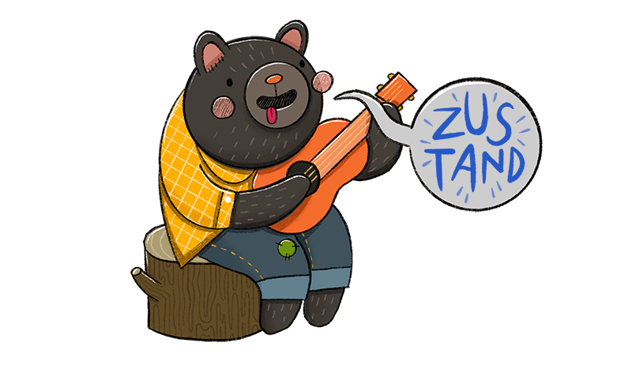
Tech Stack
TypeScript
React Navigation
Zustand

Slide 66
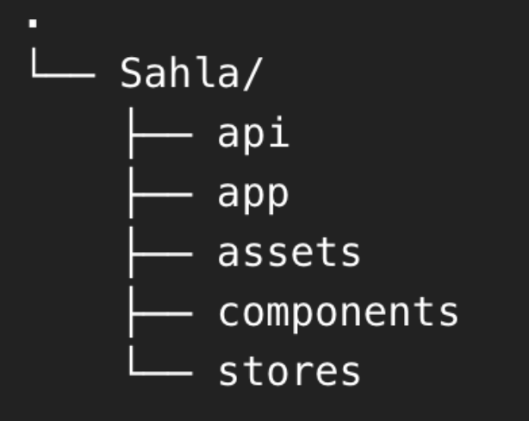
Folder Structure

Slide 67

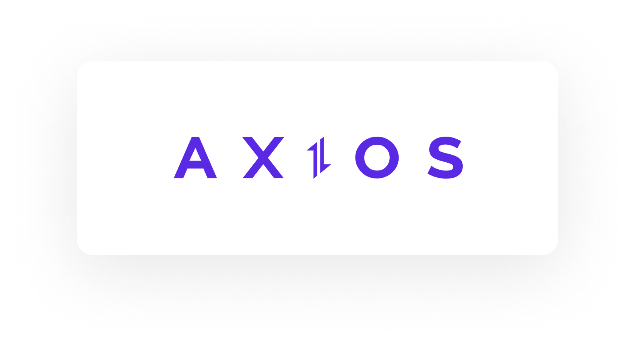
API Integration
Tanstack Query

Slide 68
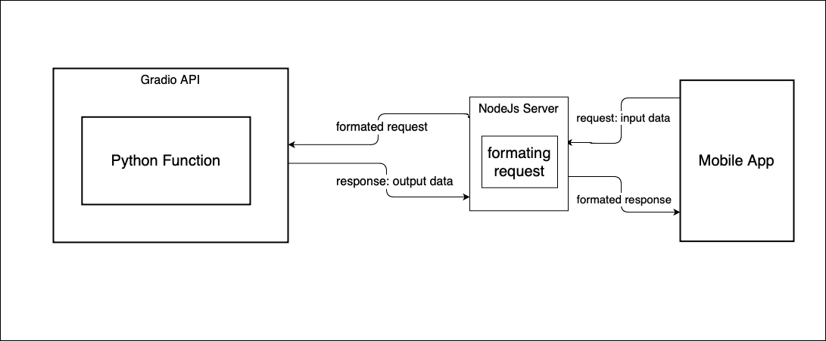
Node.js Server

Slide 69

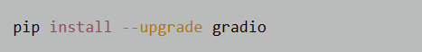
Deployment
What is ?
Installing Gradio

Slide 70
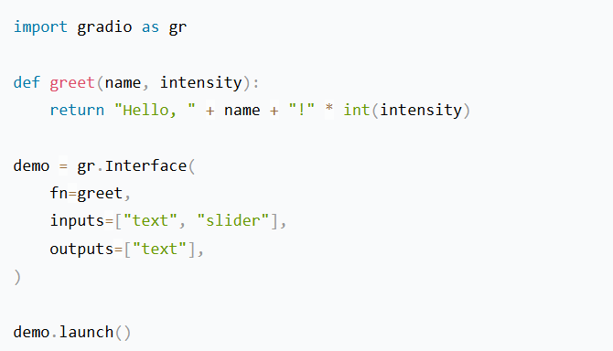
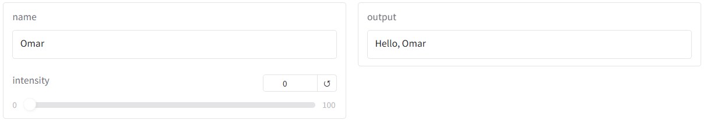
Building a demo
Gradio’s first app

Slide 71
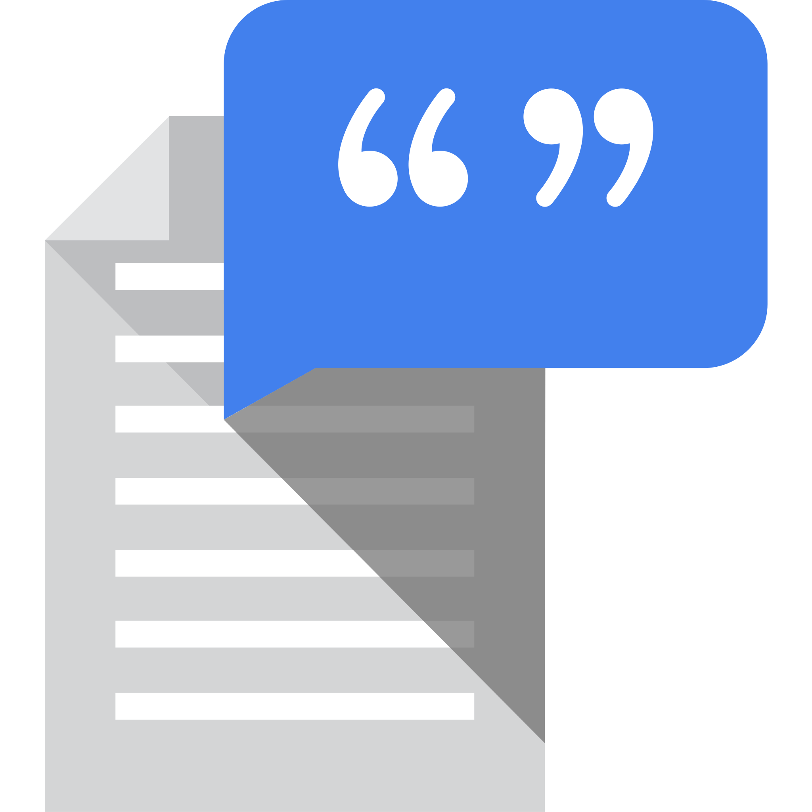
Creating APIs with Gradio

Slide 72
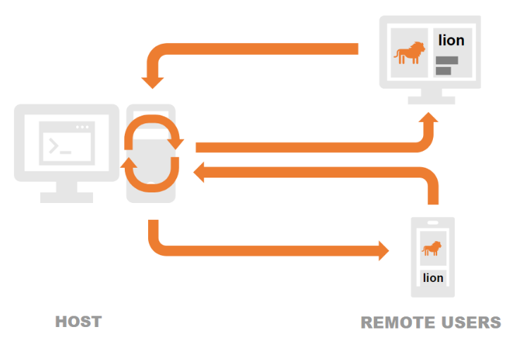
Sharing A Demo

Slide 73

Deploying on Hugging face spaces
Hugging Face Spaces
Create a Repository
Prepare Your Application Folder
Upload Files to the Repository
Build and Deploy
Access the App

Slide 74
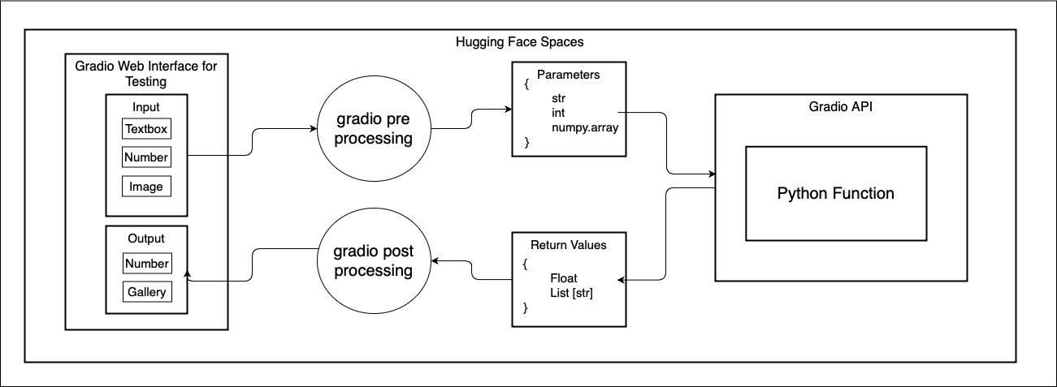

Slide 75
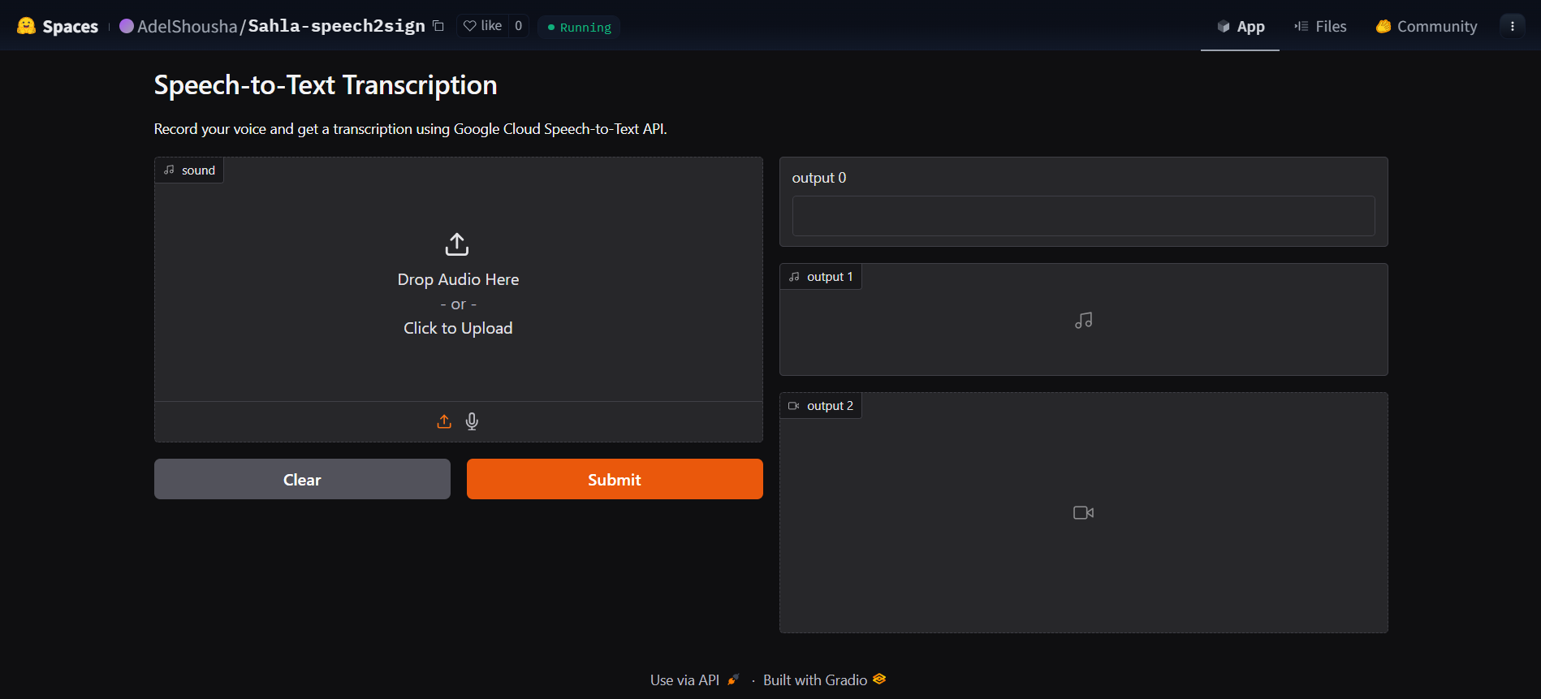
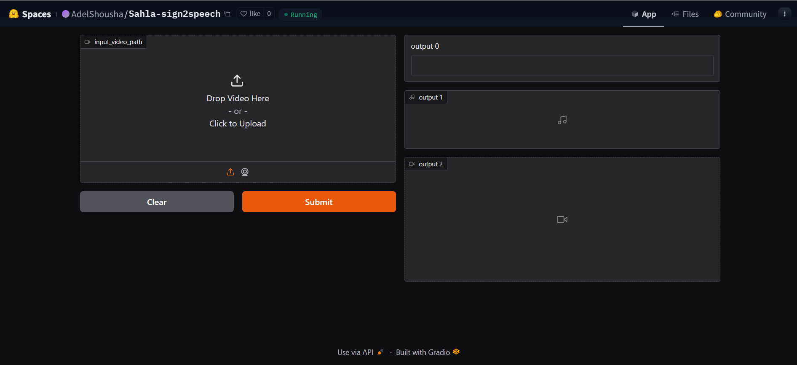
API Pages
Speech to text
Sign to speech

Slide 76
THANK YOU !

Slide 77
Adel Shousha
Karim Mashaly
Mazen Ayman
Ahmed Foda
Abd-Allah Elhoseny
Omar Amir
Ramy Waleed
Youssef Elkotby
Mohamed Ibrahim
Mostafa Shaheen

Slide 78
Adel Shousha
Karim Mashaly
Mazen Ayman
Ahmed Foda
Abd-Allah Elhoseny
Mohamed Ibrahim
Mostafa Shaheen
Omar Amir
Ramy Waleed
Youssef Elkotby

Slide 79
Adel Shousha
Karim Mashaly
Mazen Ayman
Ahmed Foda
Abd-Allah Elhoseny
Omar Amir
Ramy Waleed
Youssef Elkotby
Mohamed Ibrahim
Mostafa Shaheen

Slide 80
Adel Shousha
Karim Mashaly
Mazen Ayman
Ahmed Foda
Abd-Allah Elhoseny
Omar Amir
Ramy Waleed
Youssef Elkotby
Mohamed Ibrahim
Mostafa Shaheen

